Slide 1
The Egyptian Cultural and Educational Bureau
In collaboration with
Cairo University- Faculty of Arts
“Study in Egypt” Arabic Language and Egyptian Culture Program
Program Coordinator: Prof. Chahinda Ezzat Culturalattache@eecous.net

Slide 2
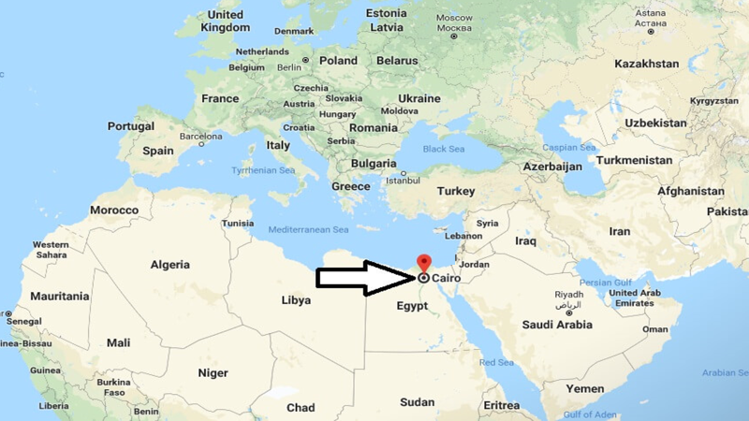
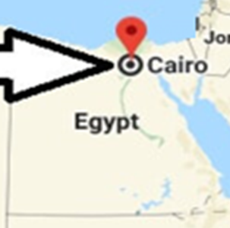
Program Description:
With its prime location in the heart of Giza, Cairo University offers undergraduate, graduate and postgraduate students an opportunity to learn the Arabic language and at the same time immerse in the mesmerizing Egyptian culture and history. Known as the cradle of civilization, Egypt is the perfect destination for international students to get acquainted with the evolution and the development of the art of writing in addition to the architectural landmarks and their correlation to the religious heritage.
The Department of Arabic Language in Cairo University meets the needs of international students who seek to acquire further knowledge of the Arabic language at the hands highly qualified and acclaimed faculty members. This program is designed to combine educational purposes with sightseeing of the most famous tourist attractions, starting with the Pharaonic architecture then the Coptic and Islamic and finally the contemporary architecture. The program mixes between classical Arabic and Egyptian colloquial Arabic.

Slide 3
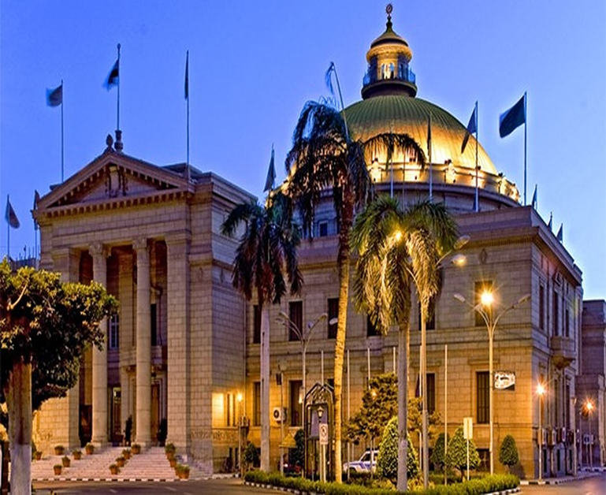
Cairo University
With its prime location in the heart of Giza, Cairo University offers undergraduate, graduate and postgraduate students an opportunity to learn the Arabic language and at the same time immerse in the mesmerizing Egyptian culture and history. Known as the cradle of civilization, Egypt is the perfect destination for international students to get acquainted with the evolution and the development of the art of writing in addition to the architectural landmarks and their correlation to the religious heritage.
The Department of Arabic Language in Cairo University meets the needs of international students who seek to acquire further knowledge of the Arabic language. This program is designed to combine educational purposes with sightseeing of the most famous tourist attractions, starting with the Pharaonic architecture then the Coptic and Islamic and finally the contemporary architecture. The program mixes between classical Arabic and Egyptian colloquial Arabic.

Slide 4
Program Structure:
This program is composed of two credit units which equates about 90 hours divided on 12 days.
3 hours outside-of-class (educational tourism) equals 1 credit-hour while 2 hours of research project equals 1 credit-hour.
Summary Table of Program-Related Work:
Program Classification | Hours | Percentage | Credit-hours
Courses | 60 | 67% | 60
Field trips | 72 | 26.5% | 24
Research project | 12 | 6.5% | 6
 |  |  | 90

Slide 5
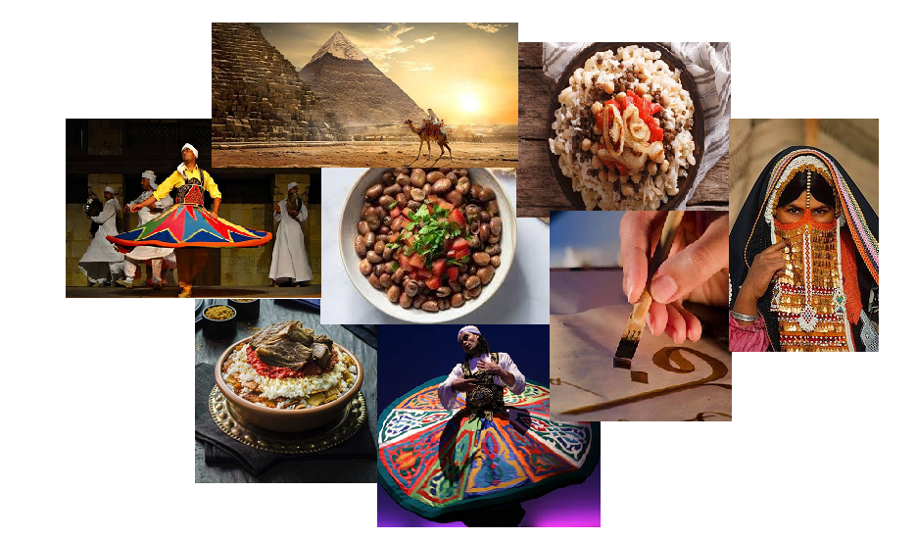
Proposed Topics for the Lectures:
1. Introductory lecture on the program (its aims and activities)
2. The Egyptian customs and traditions.
3. Coptic arts and the influence of Coptic words on colloquial Egyptian Arabic.
4. The Egyptian traditional attire and folk arts.
5. Arabic calligraphy art and its similarities with hieroglyphic writing.
6. Colloquial Arabic of Egypt (Egyptian Arabic).
7. Food culture: the Egyptian culinary.
8. Contemporary classical Arabic.
9. Arabicized terms and words: classical and colloquial Arabic.
10. The Egyptian contemporary facilities (New Suez Canal, new administrative capital ...).
11. Alexandria and its history.
12. Egypt’s contemporary cultural movement.
13.Any topic that may be in the interest of the students

Slide 6
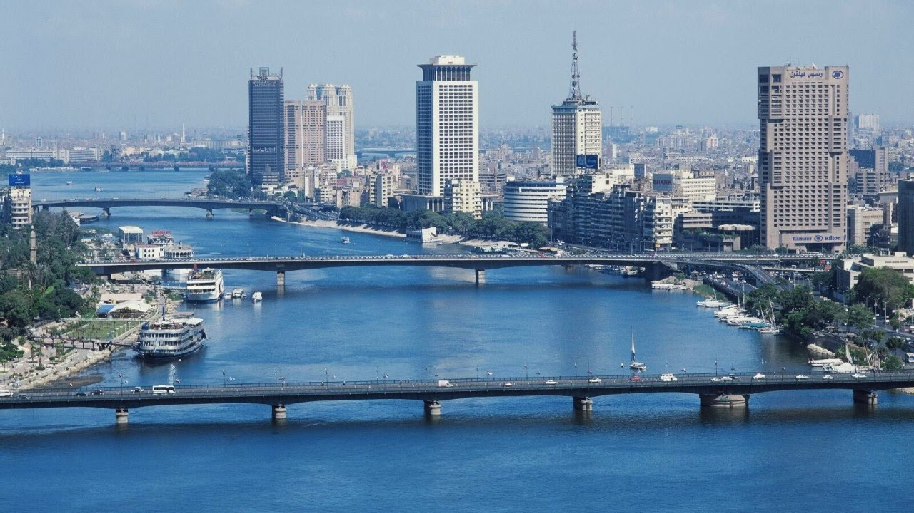
Proposed Field Trips (Educational Tourism):
1. Campus tour, University club and Nile Cruise
2. The Pyramids of Giza and The Great Sphinx.
3. Religious Complex and the Coptic Museum.
4. Al Moez Street and khan el-khalili bazaar.
5. Museum of Islamic Art.
6. The National Museum of Egyptian Civilization and Cairo Tower.
7. Al-Azhar Mosque, Al-Hussain Mosque, El Ghoryaa and one of the oldest cafes located in Old Egypt.
8. Al-Azhar Park, Salah Al-Din Citadel and Sultan Hassan Mosque.
9. The Egyptian Museum and Abdeen Palace.
10. The Aquarium Grotto Garden and the Pharaonic Village.
11. The National Center for Translation, the Supreme Council of Culture and Cairo Opera House.

Slide 7
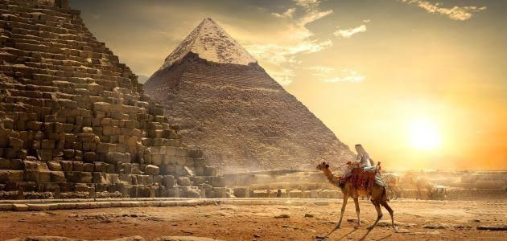
Topics
Field Trips

Slide 8
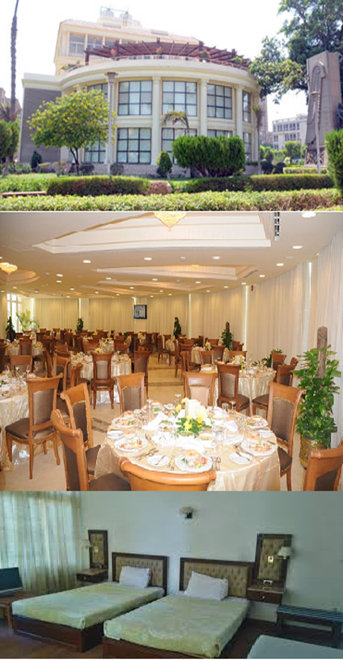
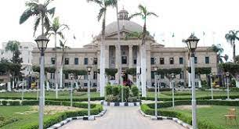
Day one:
Meet-and-greet at the hotel/guest house with professors.
Lunch
Introductory lecture on the program (its aims and activities)
Cultural activity: Campus tour, Nile Cruise

Slide 9
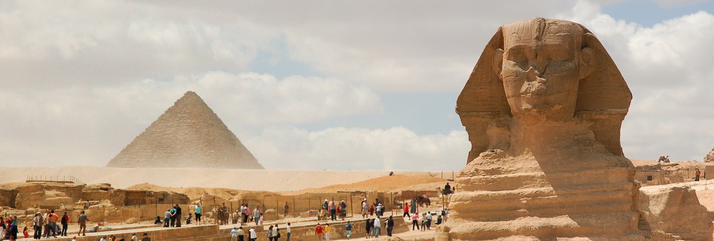
Day two:
Lecture on the Egyptian customs and traditions.
Cultural activity: site visit to the Pyramids of Giza and The Great Sphinx.

Slide 10
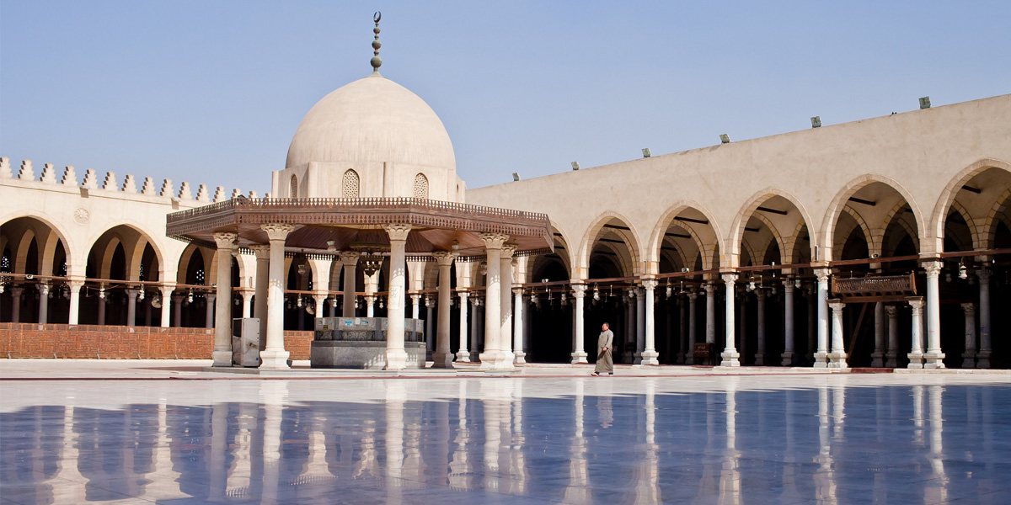
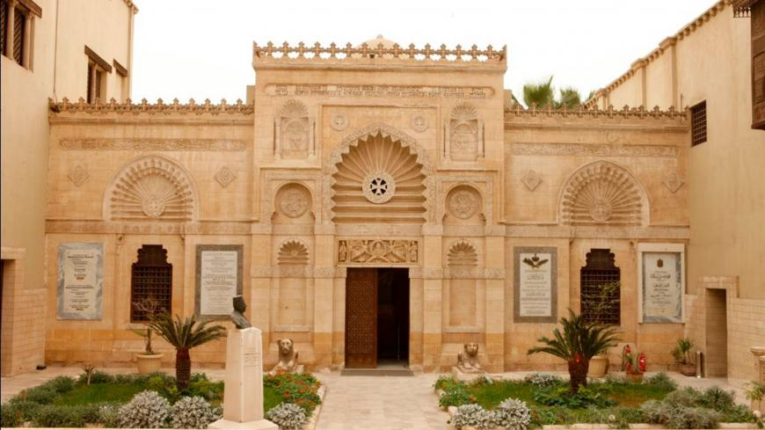
Day three:
Lecture on Coptic arts and the influence of Coptic words on colloquial Egyptian Arabic.
Cultural activity: site visit to the Religious Complex and the Coptic Museum.

Slide 11
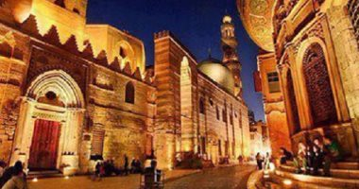
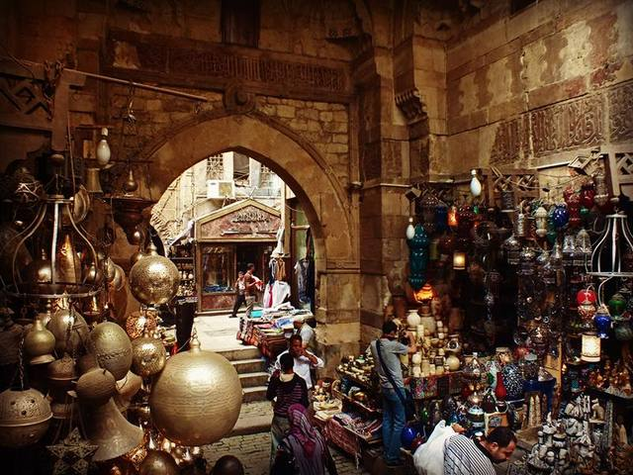
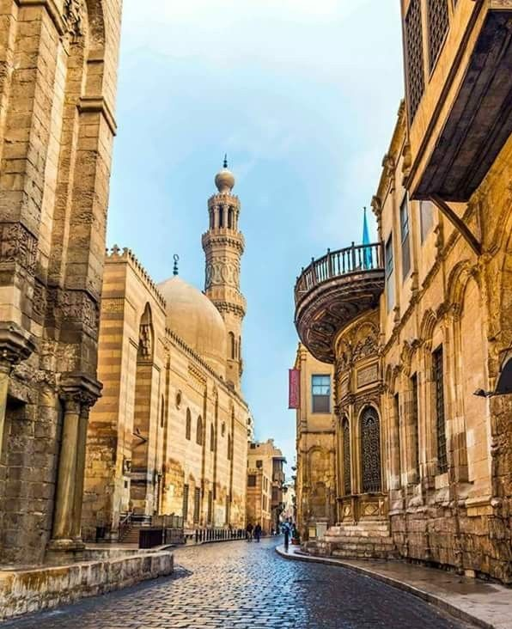
Day four:
Lecture on the Egyptian traditional attire and folk arts.
Cultural activity: site visit to Al Moez Street and khan el-khalili bazaar.

Slide 12
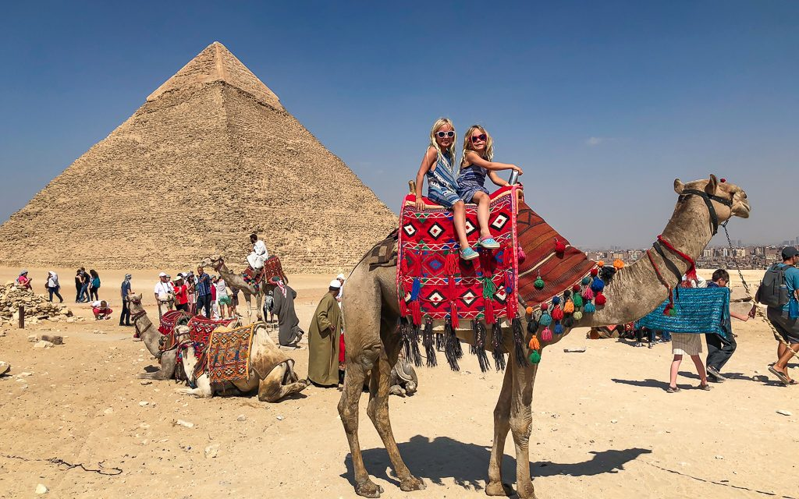
Topics
Field Trips

Slide 13
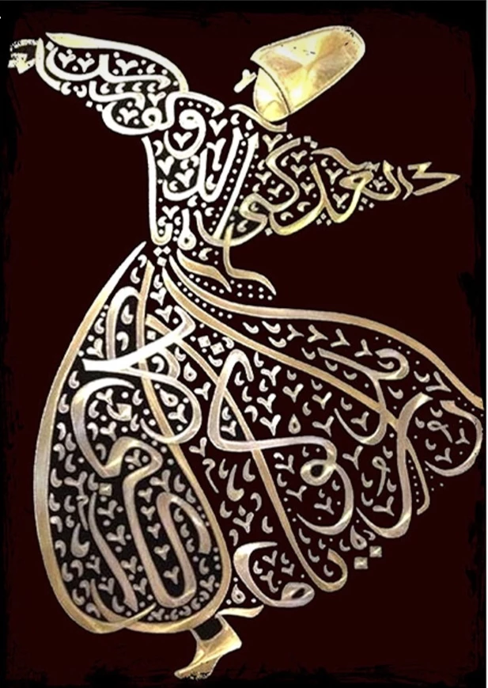
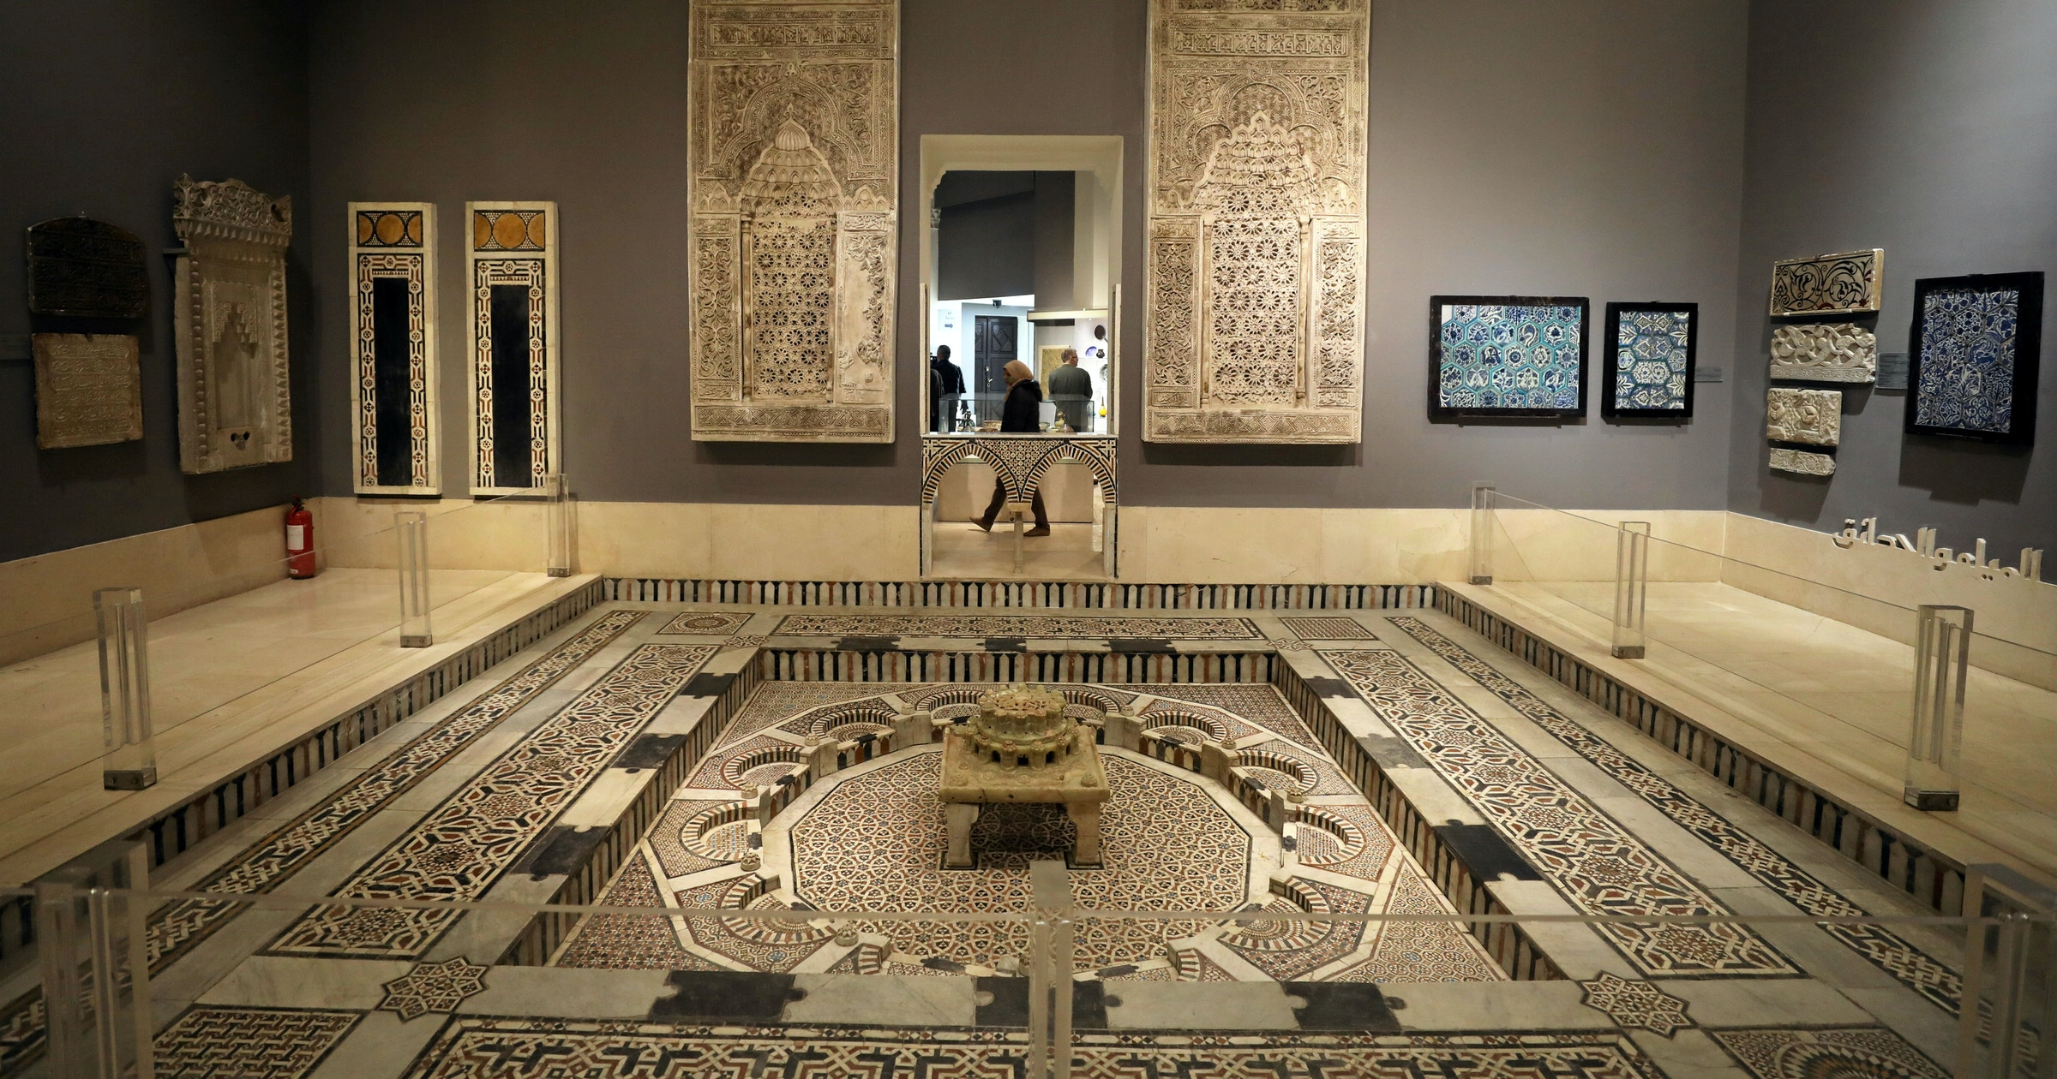
Day five:
Lecture on Arabic calligraphy art and its similarities with hieroglyphic writing.
*Arabic calligraphy workshop
Cultural activity: site visit to Museum of Islamic Art.

Slide 14
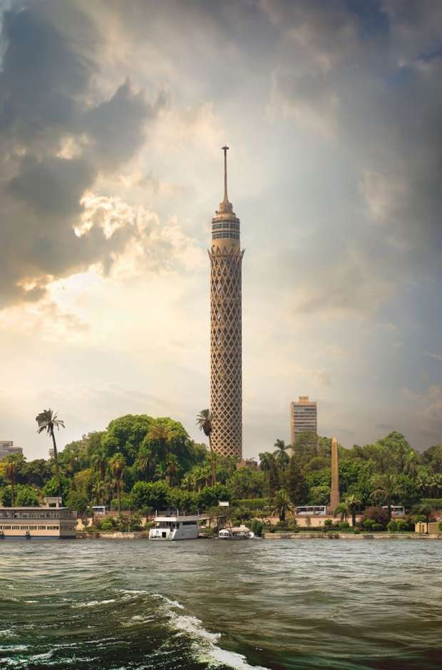
Day six:
Lecture on colloquial Arabic of Egypt (Egyptian Arabic).
Cultural activity: site visit to the National Museum of Egyptian Civilization and Cairo Tower.

Slide 15
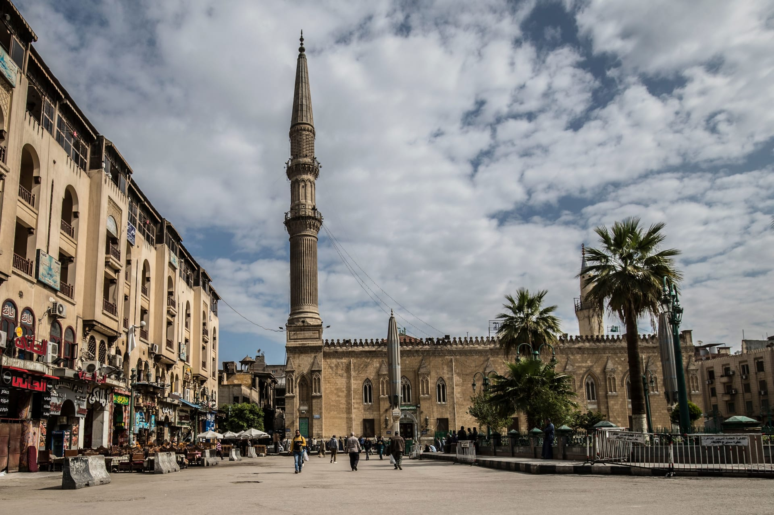
Day seven:
Lecture on food culture: the Egyptian culinary.
Cultural activity: site visit to Al-Azhar Mosque, Al-Hussain Mosque, El Ghoryaa and one of the oldest cafes located in Old Egypt.

Slide 16
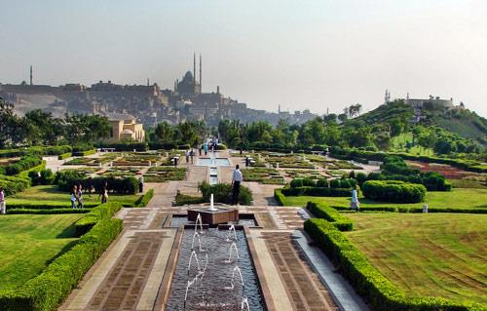
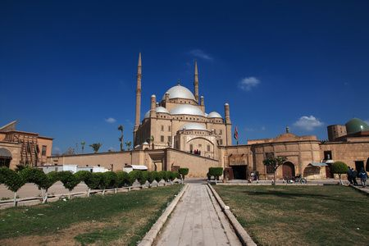
Day eight:
Lecture on contemporary classical Arabic.
Cultural activity: site visit to Al-Azhar Park, Salah Al-Din Citadel and Sultan Hassan Mosque.

Slide 17
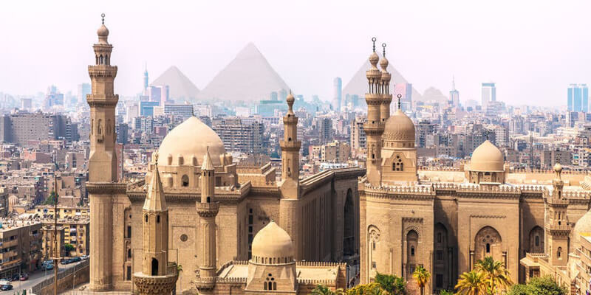
Topics
Field Trips

Slide 18
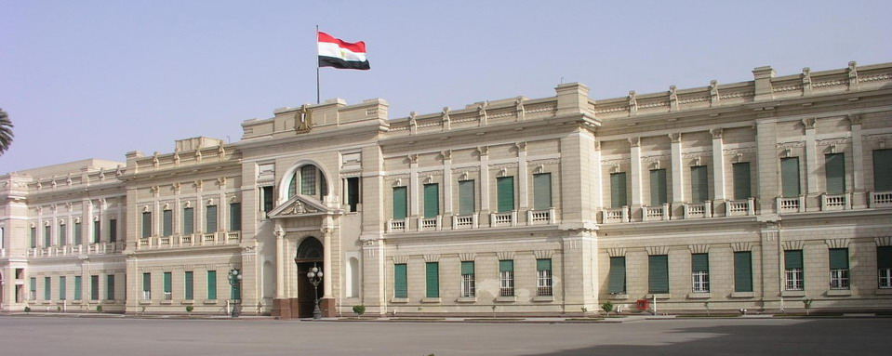
Day nine:
Lecture on Arabicized terms and words: classical and colloquial Arabic.
Cultural activity: site visit to the Egyptian Museum and Abdeen Palace.

Slide 19
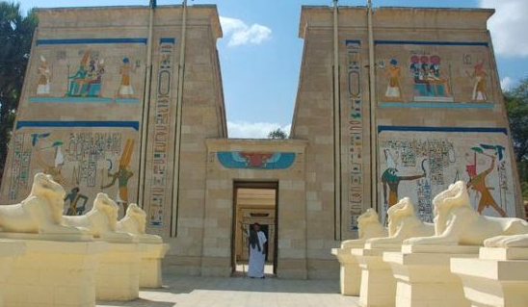
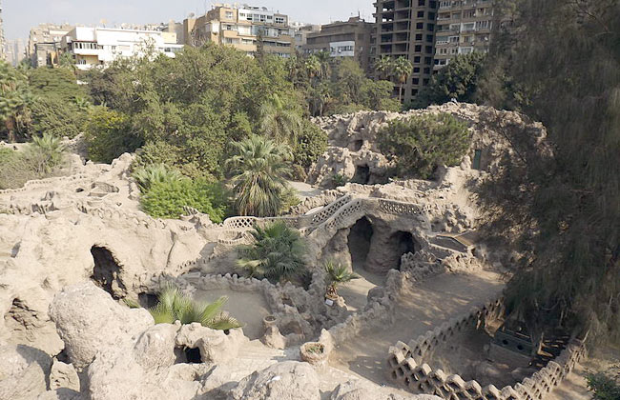
Day ten:
Lecture on Egyptian contemporary facilities (New Suez Canal, new administrative capital ...) .
Cultural activity: site visit to the Aquarium Grotto Garden and the Pharaonic Village.

Slide 20
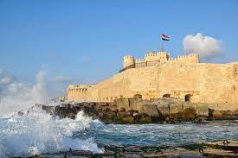
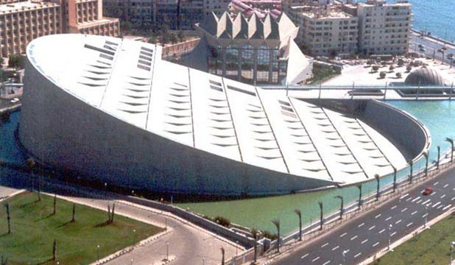
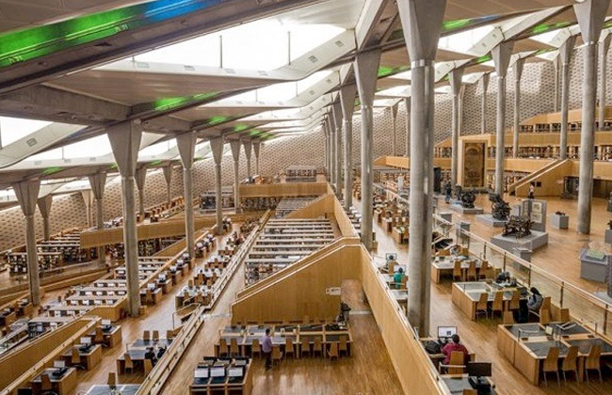
Day eleven:
Lecture on Alexandria and its history.
Cultural activity: site visit to Bibliotheca Alexandrina and the Citadel of Qaitbay.

Slide 21
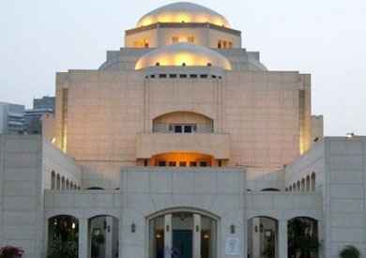
Day twelve:
Lecture on Egypt’s contemporary cultural movement.
Culture activity: site visit to the National Center for Translation, the Supreme Council of Culture and Cairo Opera House
Program Closing farewell

